Slide 1
Immune-Related Adverse Events
Ori S.
01/10/2024

Slide 2
Outline
1
Cohort description
2
AE’s prediction and prediction of multiple AE occurences
3
Systemic AE’s
4
Severe AE’s
5
Conclusions

Slide 3
Cohort Description

Slide 4
Cohort description – exclusion criterions
Patients in Viedoc since 9/2023
???
Total patients
(Viedoc NSCLC 9/2023) 1210
Excluded centers:
IL-006 (96), DE-040 (66), IL-016 (26), GB-025 (20), ES-044 (15), IL-007 (12), US-032 (12), US-153 (11), IL-004 (10), US-034 (9), GB-023 (8), IL-011 (6), US-151 (6), US-033 (4), IL-005 (4), US-036 (4), IL-002 (1), US-150 (1)
Patients without excluded centers
899
Patients without Heidelberg
395
DE-041 (504)
Non-eligible patients (132): Received neither Mono/Combo treatment (67), No AE with PFS event lower than 100 days (39), No T0 (22), No first treatment date (20), Mutation detected (13), Other malignancy (7), Unknown treatment (CT) (4), Prior chemo ended 1 months or less before blood collection (2), No consent (1)
Eligible patients: 263
With T0 measurement: 246
With AE label: 221
T0 not analyzed (14/07/2024) (17) No AE label (25)
Dev
168
Val
53

Slide 5
Cohort description – exclusion criterions
Patients in Viedoc since 9/2023
???
Total patients
(Viedoc NSCLC 9/2023) 1210
Patients without excluded centers
610
Excluded centers:
IL-006 (96), DE-041 (504)
Todo: Mono/Mono+Combo
Non-eligible patients (132): Received neither Mono/Combo treatment (67), No AE with PFS event lower than 100 days (39), No T0 (22), No first treatment date (20), Mutation detected (13), Other malignancy (7), Unknown treatment (CT) (4), Prior chemo ended 1 months or less before blood collection (2), No consent (1)
Eligible patients: __
With T0 measurement: __
With AE label: __
T0 not analyzed (07/10/2024) (__) No AE label (__)
Dev
__
Val
__

Slide 6
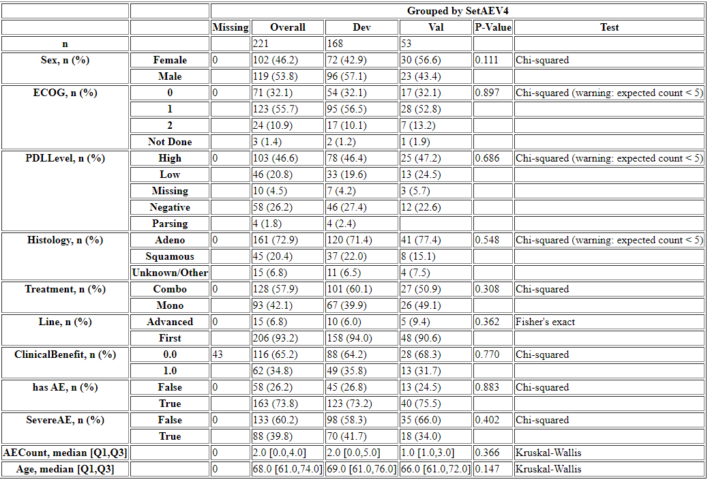
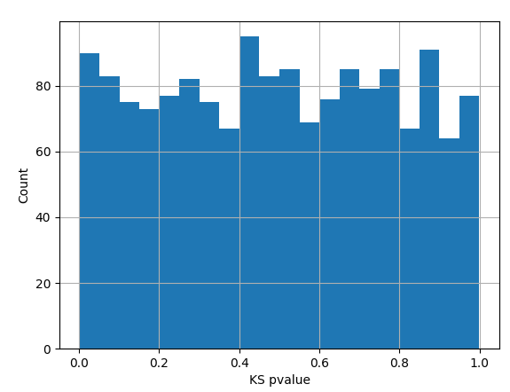
Cohort description – Dev/Val sets

Slide 7
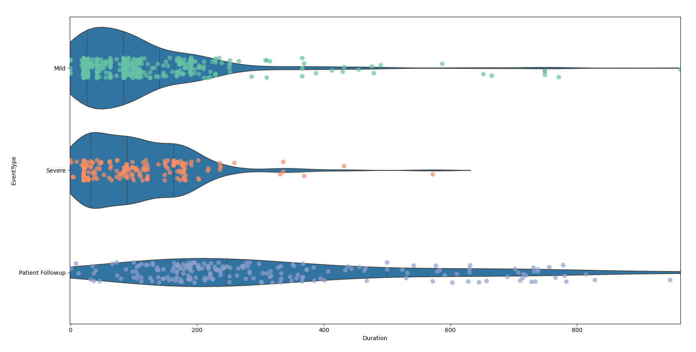
AE’s duration and follow-up since 1st treatment
 | Within 100 days | Within 180 days | Within 540 days
AE occurrences | 62% | 84% | 98%
Severe AE occurrences | 56% | 88% | 99%
Patients' follow-up | 92% | 72% | 24%

Slide 8
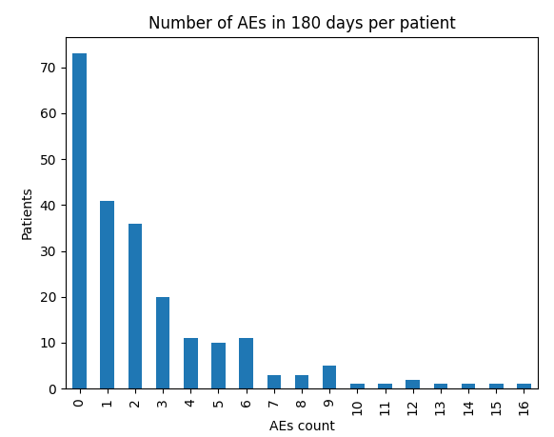


Number of AE’s per patient (in 180 days of treatment)

Slide 9
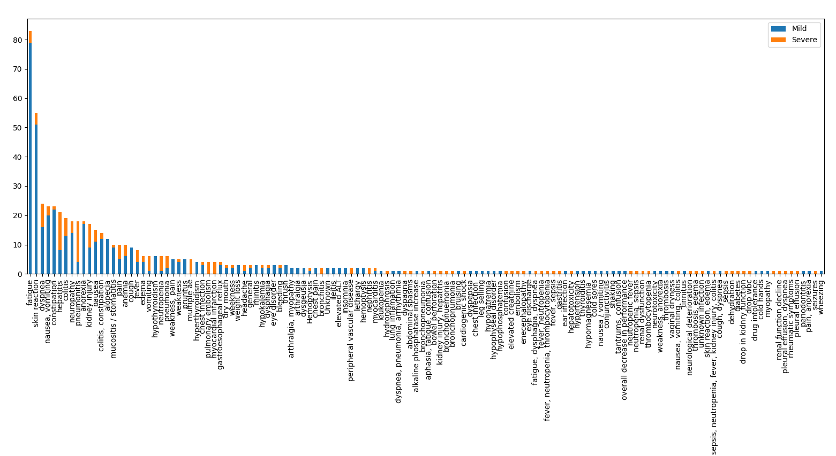
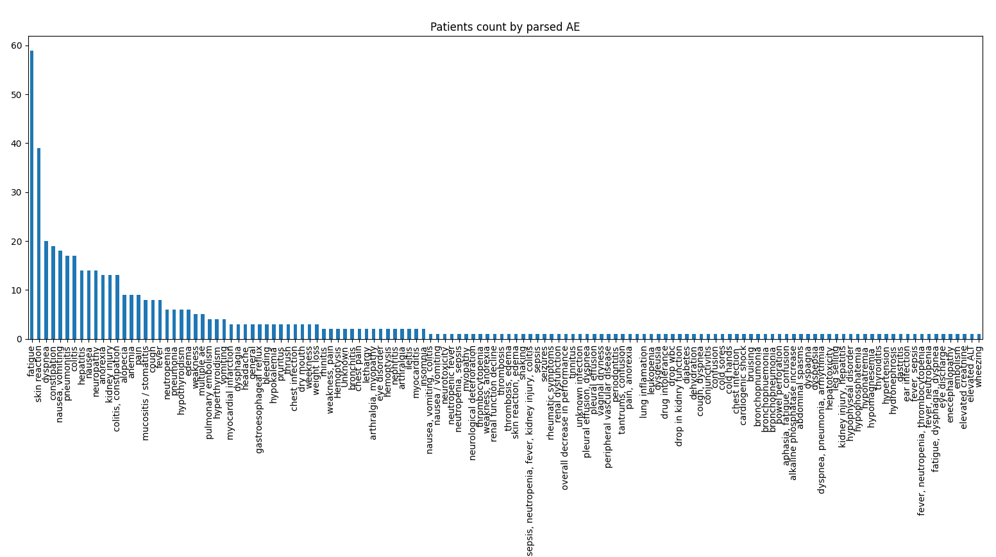
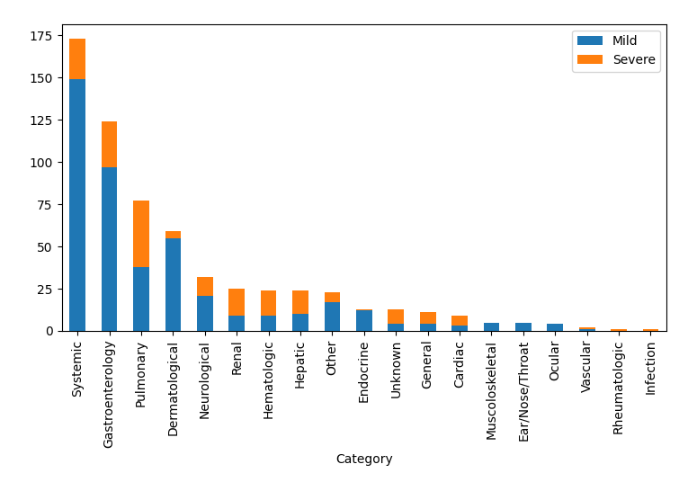
Parsed AE

Slide 10
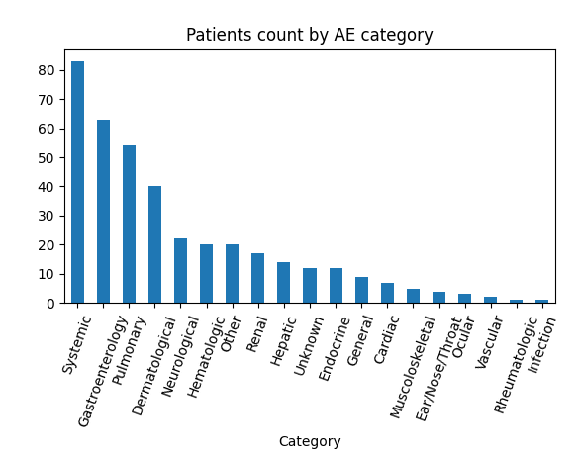
AE categories

Slide 11
Number of AE’s

Slide 12
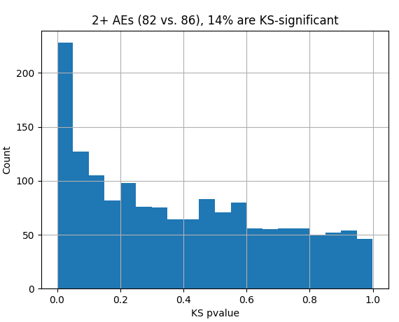
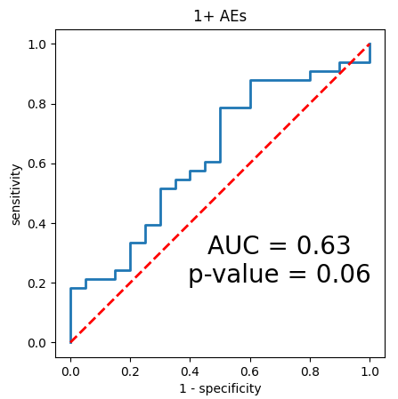
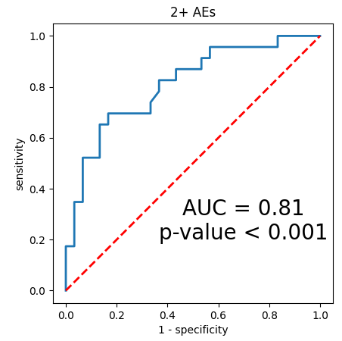
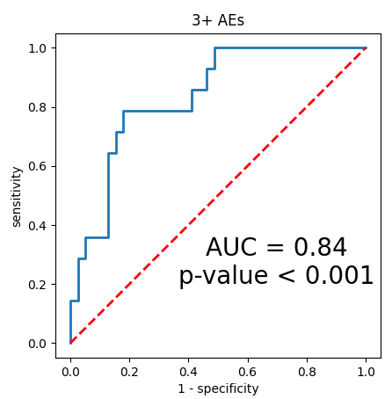
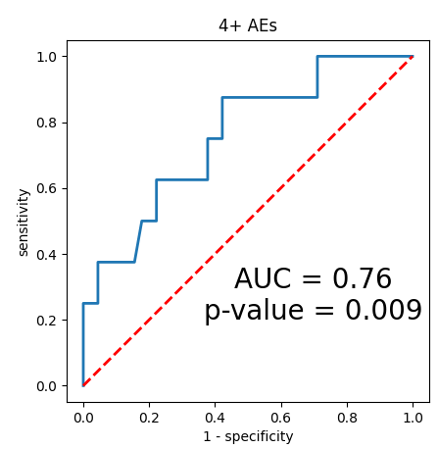
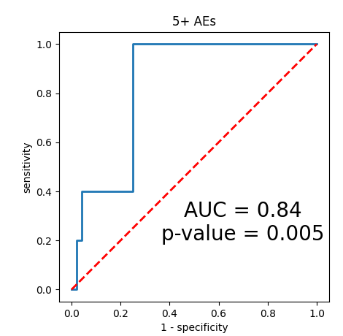
Label testing – AUC by number of AEs in 180 days
AE count | Significant aptamers [%] | Dev set portion [N (%)] | Dev AUC | Val set portion [N (%)] | Val AUC
1+ | 11% | 114 (68%) | 0.68 | 33 (62%) | 0.63
2+ | 14% | 82 (49%) | 0.75 | 23 (43%) | 0.81
3+ | 13% | 55 (33%) | 0.72 | 14 (26%) | 0.84
4+ | 12% | 43 (26%) | 0.72 | 8 (15%) | 0.76
5+ | 9% | 35 (21%) | 0.68 | 5 (9%) | 0.84
Significant aptamers

Slide 13
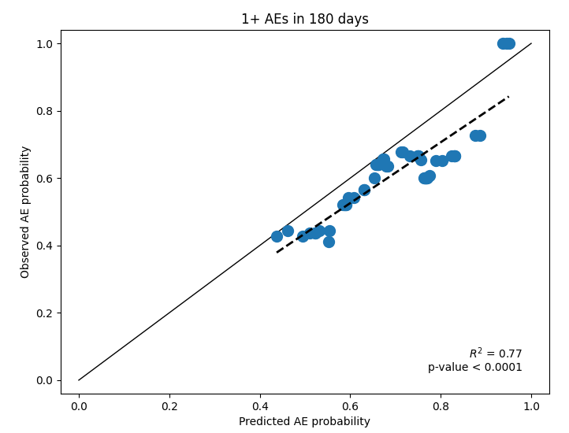
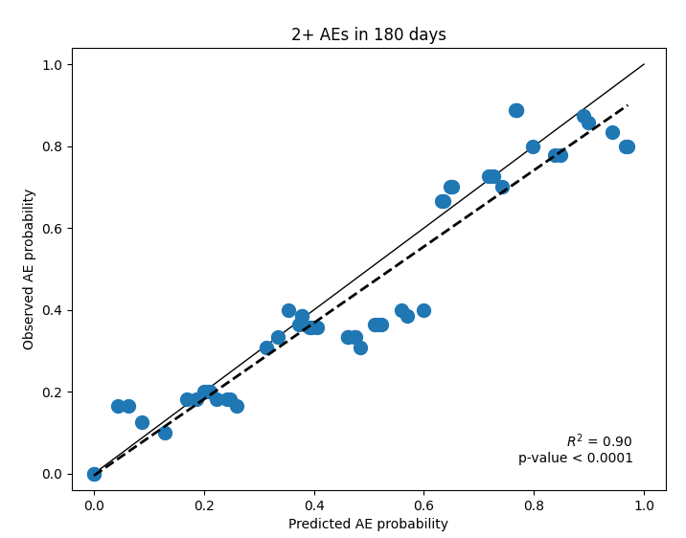
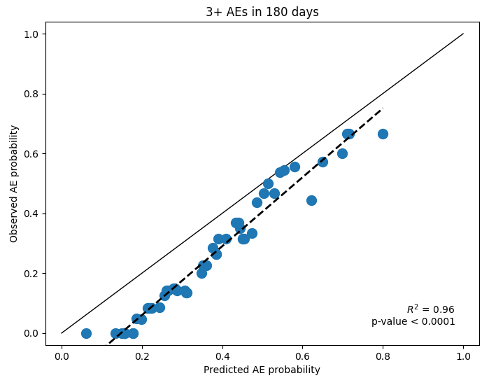
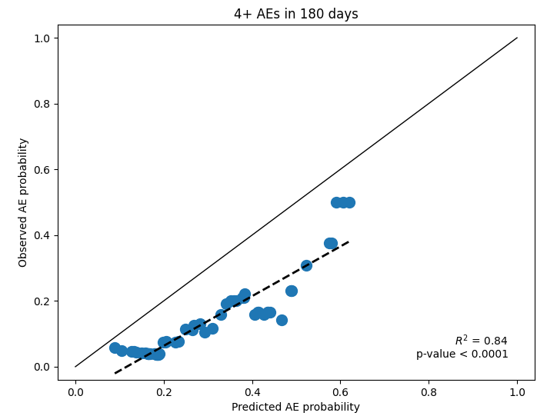
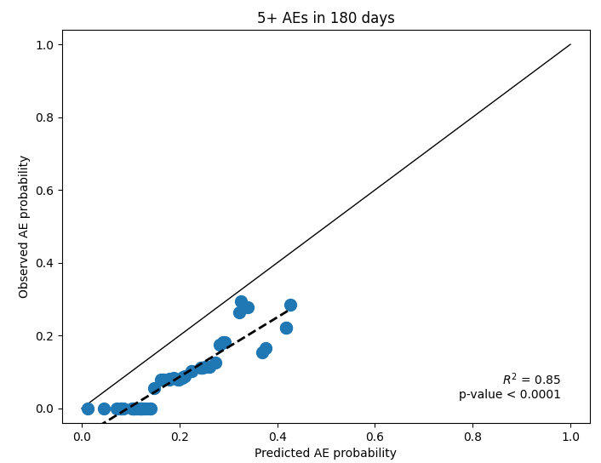
Label testing – R^2 by number of AEs in 180 days
R^2 parameters:
Data: Dev set (168 patients), Val set (53 patients)
Interval: 0.1
AE count | Dev set portion [N (%)] | Dev R^2 | Val set portion [N (%)] | Val R^2
1+ | 114 (68%) | 0.95 | 33 (62%) | 0.77
2+ | 82 (49%) | 0.93 | 23 (43%) | 0.90
3+ | 55 (33%) | 0.87 | 14 (26%) | 0.96
4+ | 43 (26%) | 0.98 | 8 (15%) | 0.84
5+ | 35 (21%) | 0.95 | 5 (9%) | 0.85

Slide 14
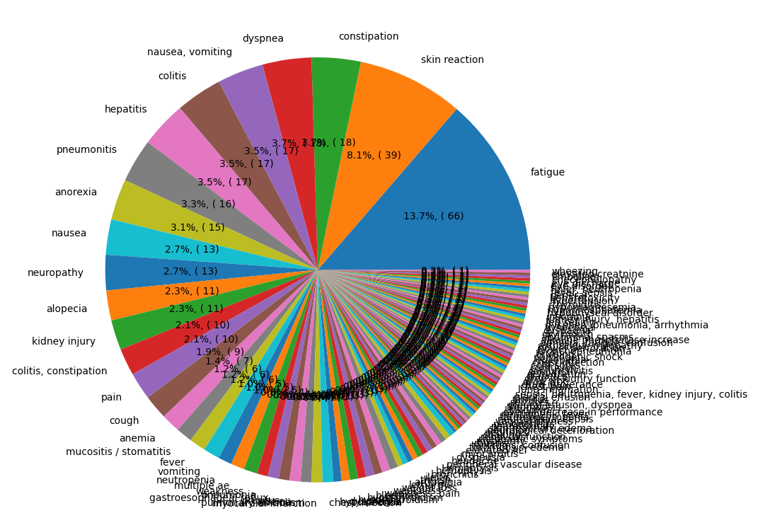
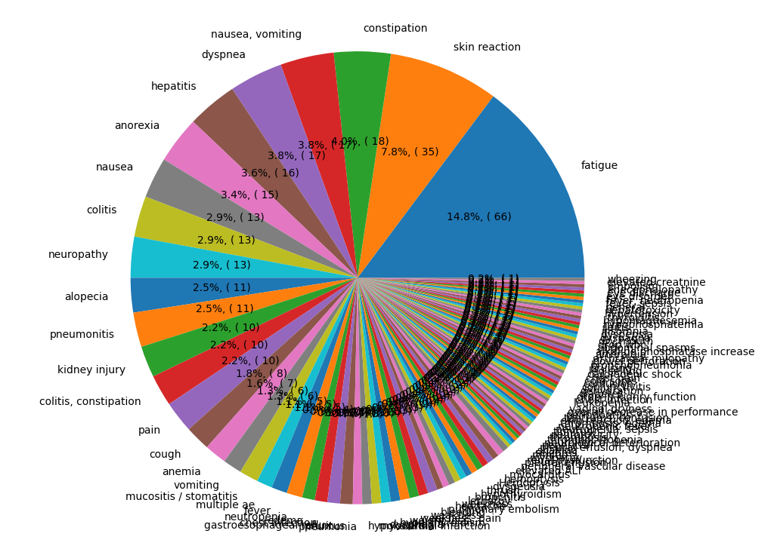
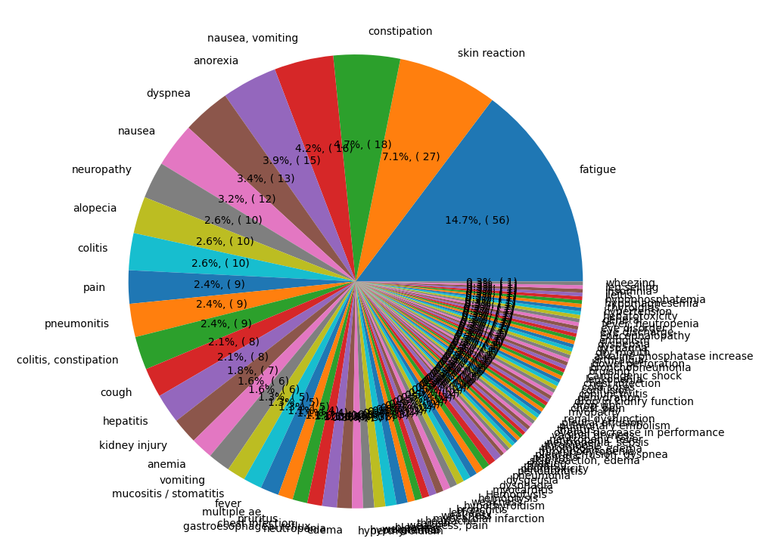
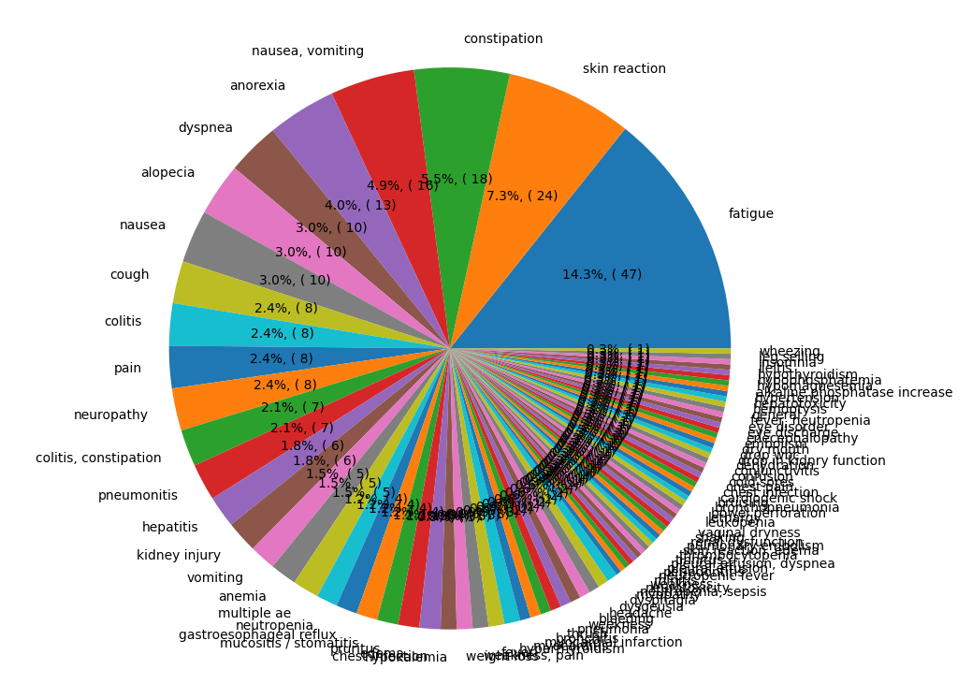
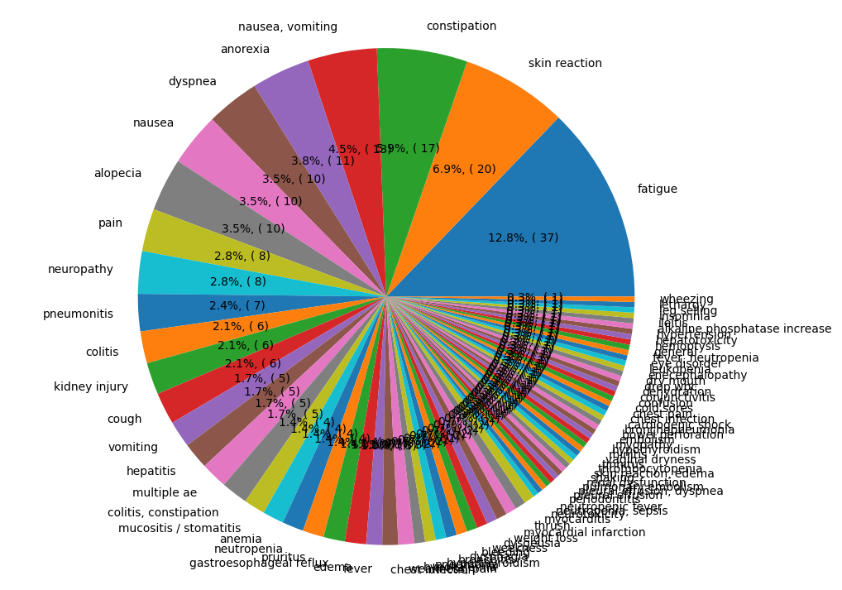
AE types breakdown by number of AE’s per patient
1+ AE’s
per patient
2+ AE’s
per patient
3+ AE’s
per patient
4+ AE’s
per patient
5+ AE’s
per patient

Slide 15
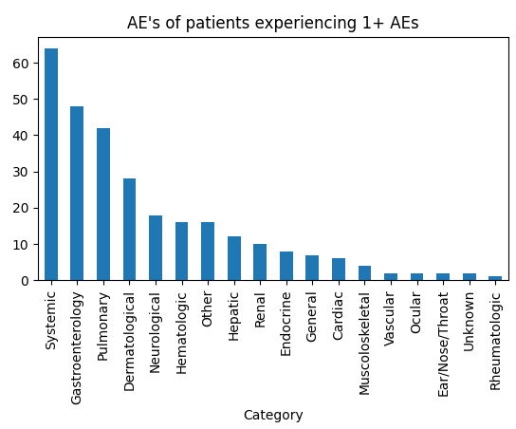
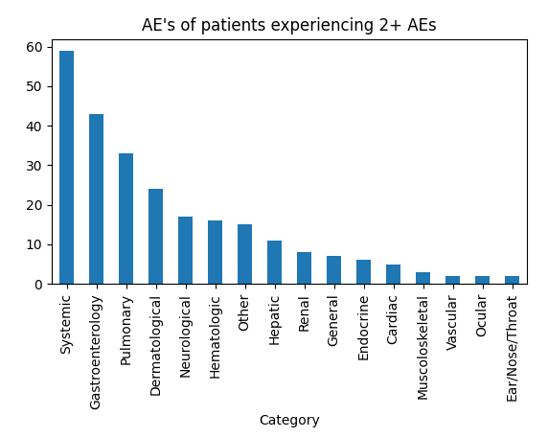
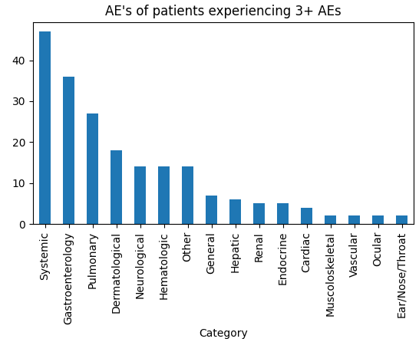
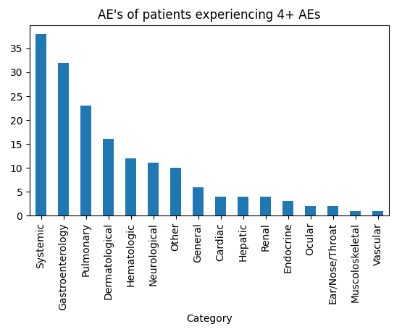
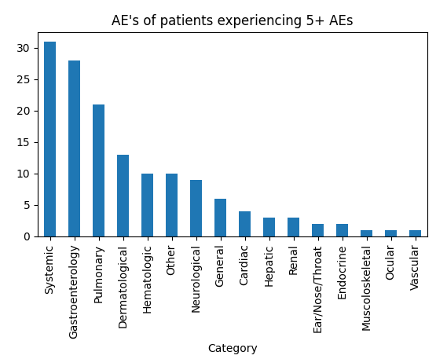
AE categories breakdown by number of AE’s per patient

Slide 16
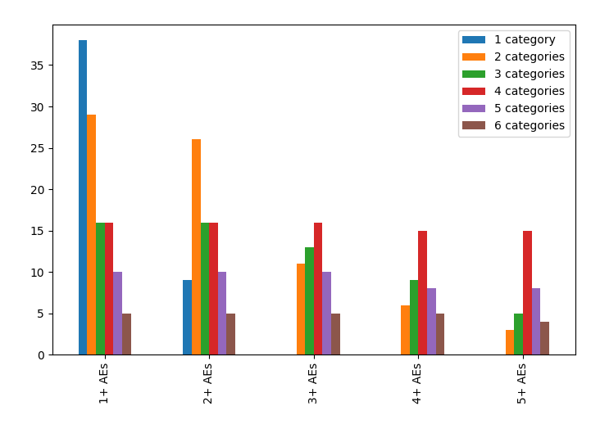
AE categories count by number of AE’s per patient

Slide 17
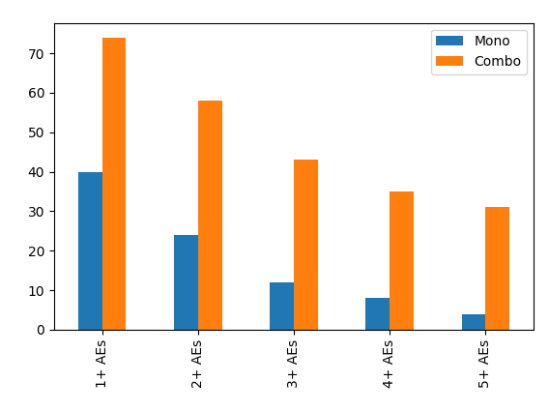
Treatment type by number of AE’s per patient

Slide 18
Systemic AE’s

Slide 19
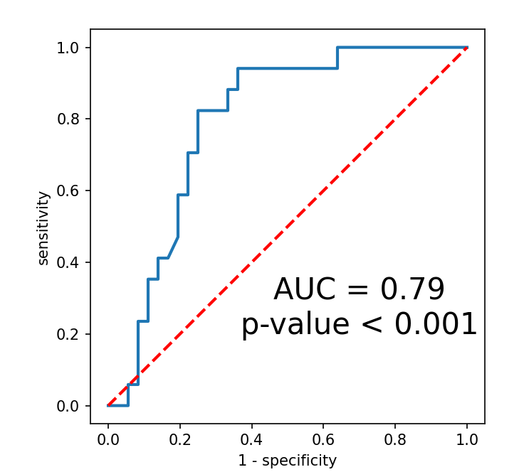
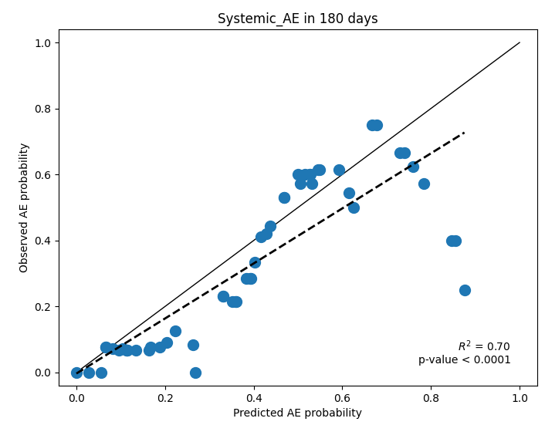
Systemic AE prediction – Dev,Val sets reporting
Dev set AUC: 0.74
Dev set R^2: 0.81
61 True vs. 107 False
Val set AUC: 0.79
Val set R^2: 0.70
17 True vs. 36 False

Slide 20
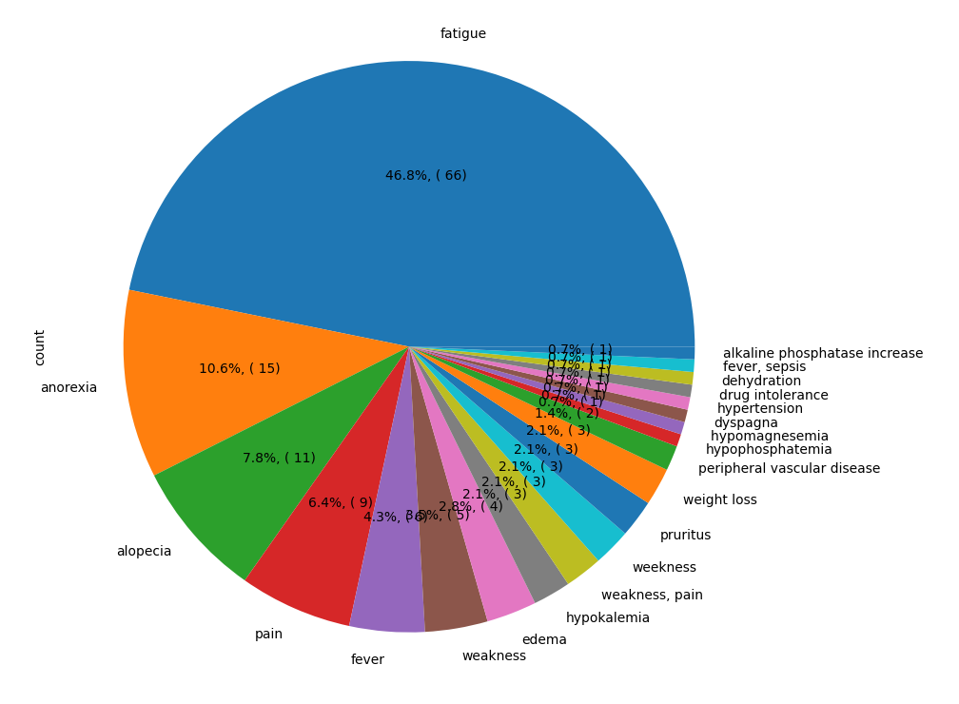
Systemic AE’s – what it means?

Slide 21

Systemic AE dataset – Dev set reporting
PDL low of higher fraction among patients with Systemic AE, on expense of PDL high
CB 1 of lower fraction among patients with systemic AE
Patients with systemic AE are more likely to experience AE’s in general
*
*
*
*
*
*
*
*
*
*
*
*

Slide 22
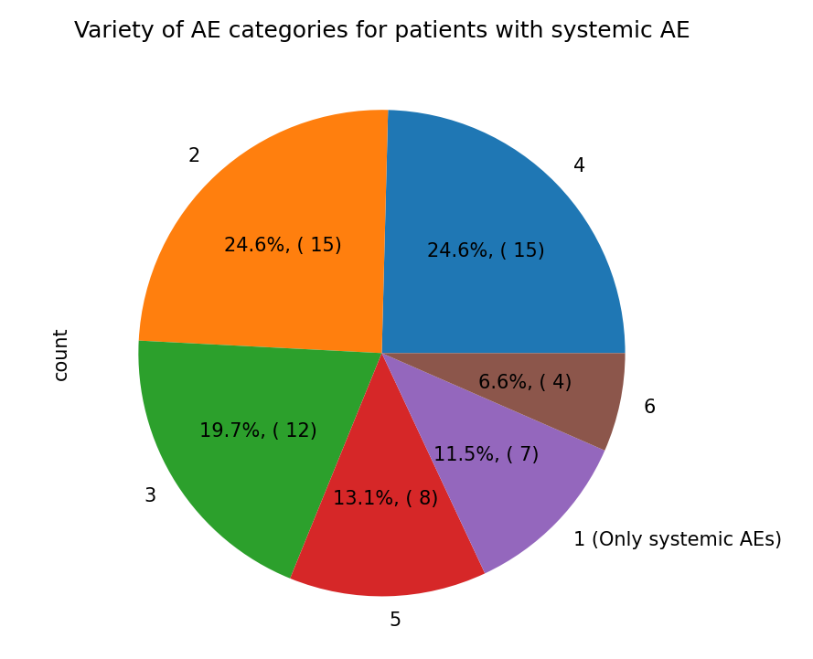
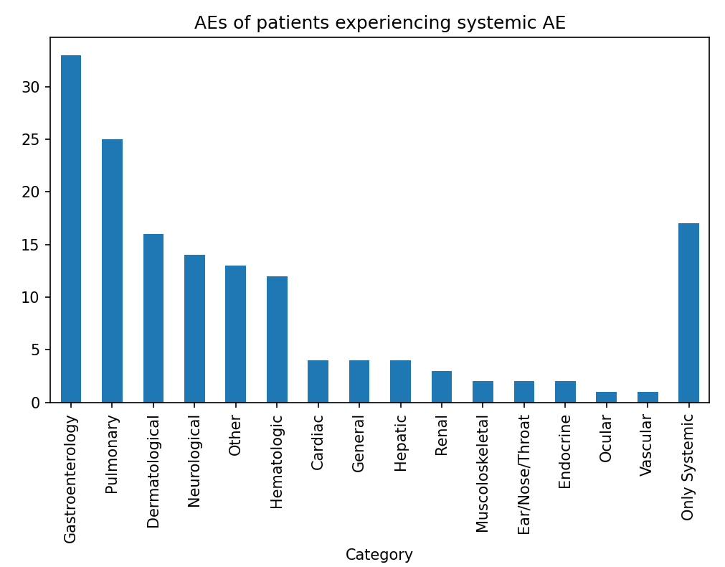
AE’s among systemic AE patients – Dev set reporting
most of patients who experience systemic AE’s experience other AE’s as well, from at least 2 categories, on top of Systemic.

Slide 23
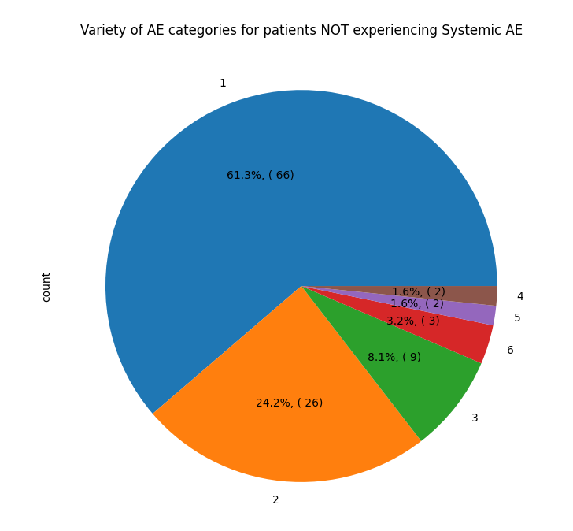
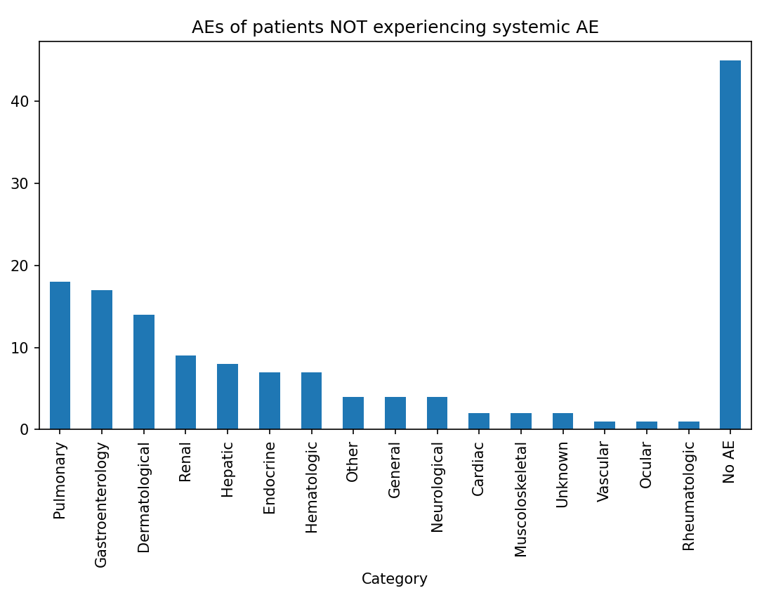
AE’s among patients w/o systemic AE – Dev set reporting
Patients who don’t experience systemic AE’s and do experience AE of some kind, will most likely experience AE’s of a single category.

Slide 24
Severe AE’s

Slide 25
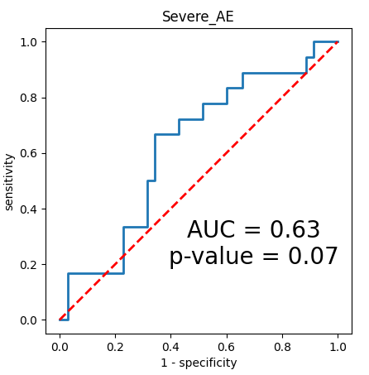
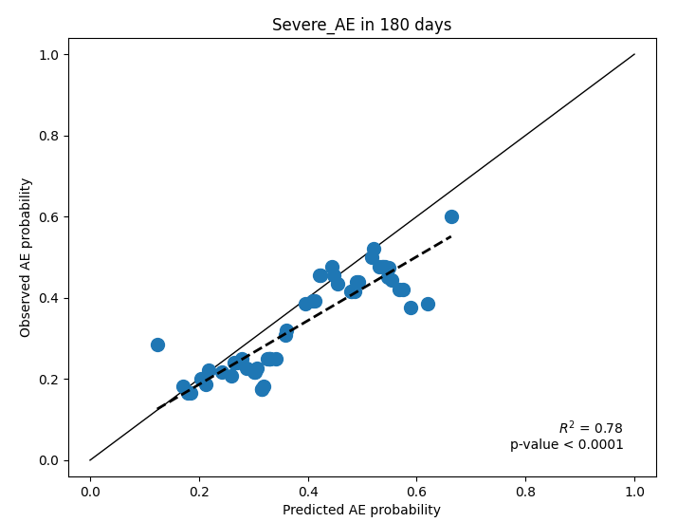
Severe AE prediction – Dev set reporting
We trained a model to predict severe AEs occurrence during the treatment period, without a specific timeframe
Dev set: 70 True vs. 98 False
Dev set AUC: 0.67
Dev set R^2: 0.84
Val set: 18 True vs. 35 False
Val set AUC: 0.63
Val set R^2: 0.78

Slide 26
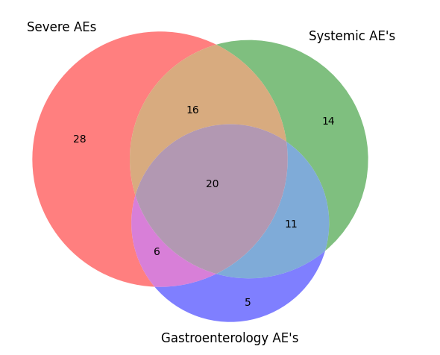
Severe AE’s in relation to systemic/gastro AE’s – Dev set reporting
68

Slide 27
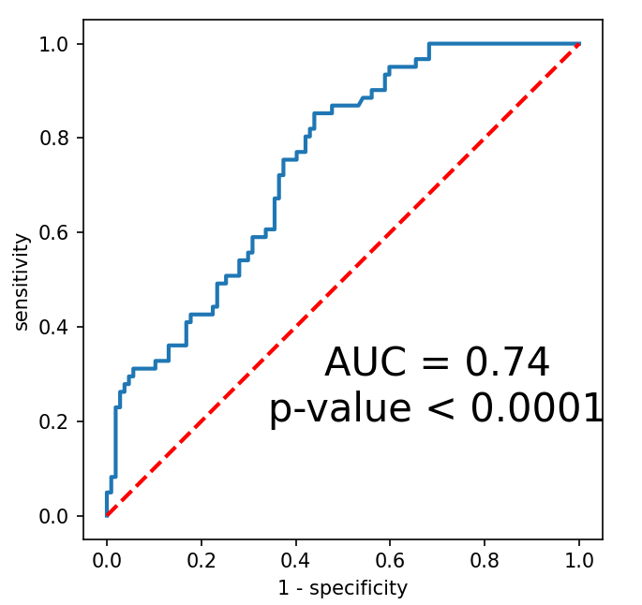
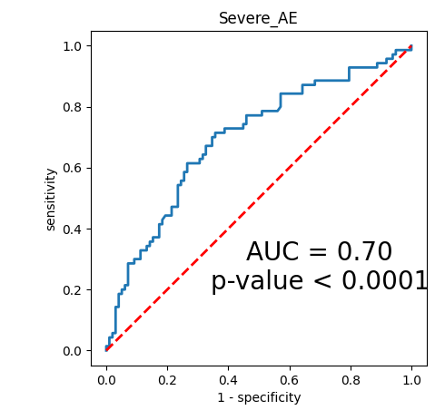
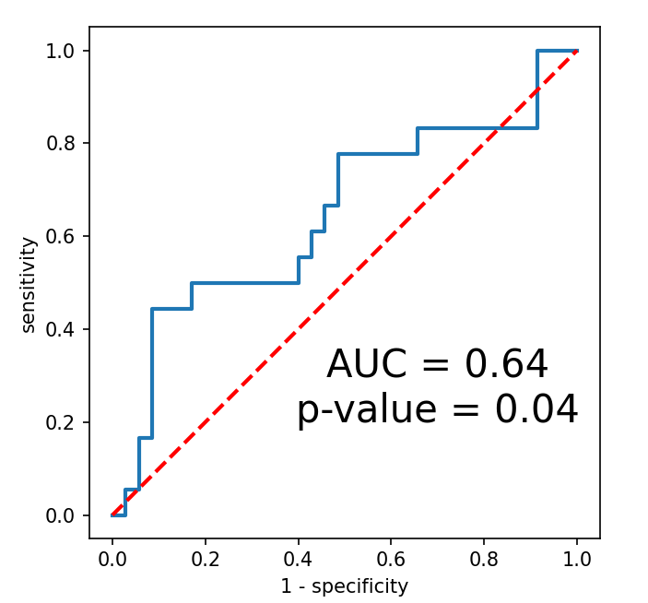
Predicting Severe AE’s with systemic AE’s predictor
Trained a model on the Dev set to predict systemic AE’s in the first 6 months of treatment
61 vs. 107
AUC=0.74
R^2=0.81
Used the model as-is on the Dev set to predict severe AE’s
70 vs. 98
AUC=0.70
R^2=0.86
Validated severe AE’s prediction on the validation set
18 vs. 35
AUC=0.64
R^2=0.44 (0.81 with interval=0.2)
I tried a similar approach with other models, nothing interesting to share..

Slide 28
Severe AE’s in relation to systemic AE’s predictor – Dev set reporting
69%
57%
90%
%Severe by predictor
57%
64%
67%
68
40%
26%

Slide 29
Conclusions
1
Immune-related labels were not helpful
2
Predict multiple AE occurrences
3
Predict occurrence of systemic AE’s and potentially other specific types and categories of AE’s
4
Predict occurrence of severe AE’s

